Slide 1
AI Tools

Slide 2
Take Home Exercise Review
Evaluate/compare two AI models (GPT 4 and Claude 3 Sonnet) based on context length and benchmarks.
Which one is best suited to help with programming related questions?

Slide 3
Task integration with AI tools
There are many ways we can use AI models to help us be more efficient in our work.
Our workflow is an important part of our efficiency, so having embedded AI tools within programs make the workflow more streamlined compared to the choppy workflow of toggling back and forth to Chat GPT.

Slide 4
AI tools
Companies like Adobe, Ableton, GitHub, Shopify, etc. are incorporating AI tools within their products.
Microsoft even has been implementing Copilot into all new machines using Windows 11 (Windows + C).
There are also many third party developers making amazing AI tools to be used inside of the programs, like a plug-in/extension.

Slide 5
Chatbots
Chatbots are an easy way to help with any sort of question.
They can help you code simple projects, but the more complex a problem is, the less helpful the response may be.
They are very helpful with explaining the concepts and breaking down the code for learning purposes.

Slide 6
Exercise
Code a simple palindrome checker script in python using Chat GPT. Try adding a feature with a revisional prompt. (Ex. Make the checker loop, so that users can check multiple strings.)

Slide 7
Code completion tools
Code completion is a tool that optimizes the workflow while still getting insight from AI.
The workflow of a programmer
Check documentation or forums for unknown solutions
Back and forth between coding and researching
Code completion reduces the time away from the coding environment.

Slide 8
Code completion tools (Intellisense)
Intellisense is a built-in AI tool within VS Code that provides code completion, parameter info, and other information and formatting that helps you code faster.
The key word being faster and not better.
This tool acts very much like Google’s search suggestions.
No generation features

Slide 9
Code completion tools (GitHub Copilot)
GitHub is a developer platform that stores a ton of open source code.
This has allowed GitHub to build a strong code assistant model that can be installed and used within IDEs (Integrated Development Environment).
This tool supports code completion, as well as in-line prompting, and side-window chatbot availability.
Blackbox is a free VS Code extension that is similar to GitHub Copilot.

Slide 10
Example
Develop a program where the computer selects a random number and the user tries to guess it. Provide hints such as "too high" or "too low" after each guess until the user correctly guesses the number.
Code this program with the various ways of using GitHub Copilot.
Comment Prompting
Inline Prompting
Side window chatbot

Slide 11
Agentic workflow
Agentic workflow creates multiple AI “agents” that have differing system messages.
The system message instills the task for that agent (Writer, Planner, etc.).
AutoGen, created by Microsoft, is one of the popular agentic workflow frameworks.
There are multiple architectures that can be achieved using AutoGen for the intended purpose.
https://github.com/microsoft/autogen/tree/main/notebook

Slide 12
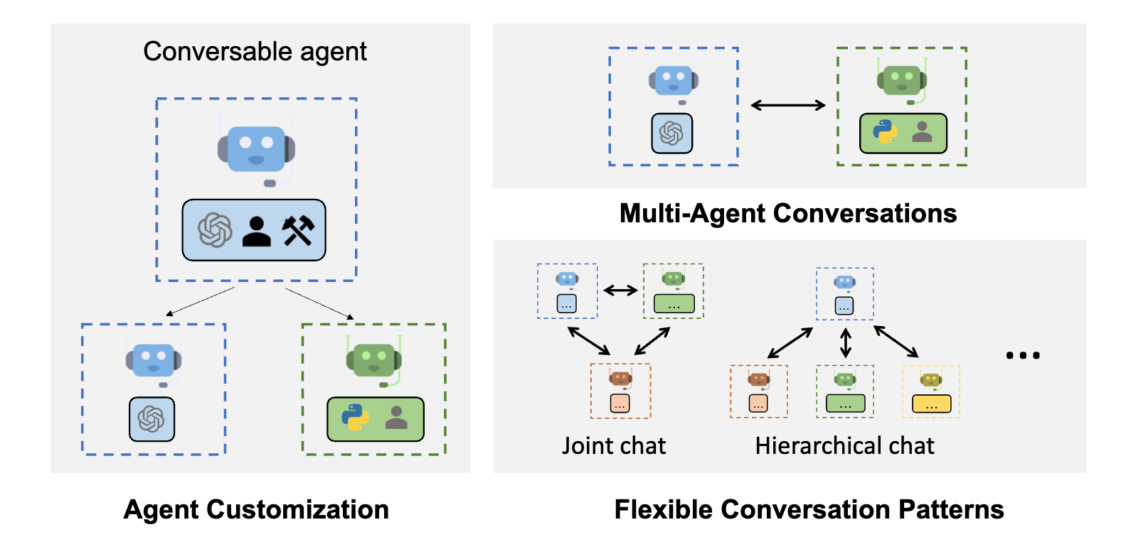
Agentic workflow

Slide 13
Auto Coders
Auto coders are programs that have been built around AI models to generate code, run the code without human interaction, and then if there are any errors, report those back to the model to generate a revised code that will be run again and again until there are no errors.
Critical thinking of effectiveness
Detail and direction is very important for successful responses.
How many generations are allowed before returning to the user?
How much oversight do assistants need?

Slide 14
Take Home Exercise
Use a chatbot to help code a simple calculator. (addition, subtraction, division, multiplication)
Try adding more features and make it user friendly with multiple revisional prompts.

